Slide 1

Streaming Platform Analysis
Team Puppies

Slide 2
Project Description
In this project we will analyze a dataset containing every television show streamed on Netflix, Hulu, Amazon Prime, and Disney plus to find out:
How the target audience varies between platforms?
When are most of the shows produced?
Differences between IMDB and Rotten Tomatoes?
Average ratings for each platform and their highest rated shows?

Slide 3
What are the Target Audiences?

Slide 4
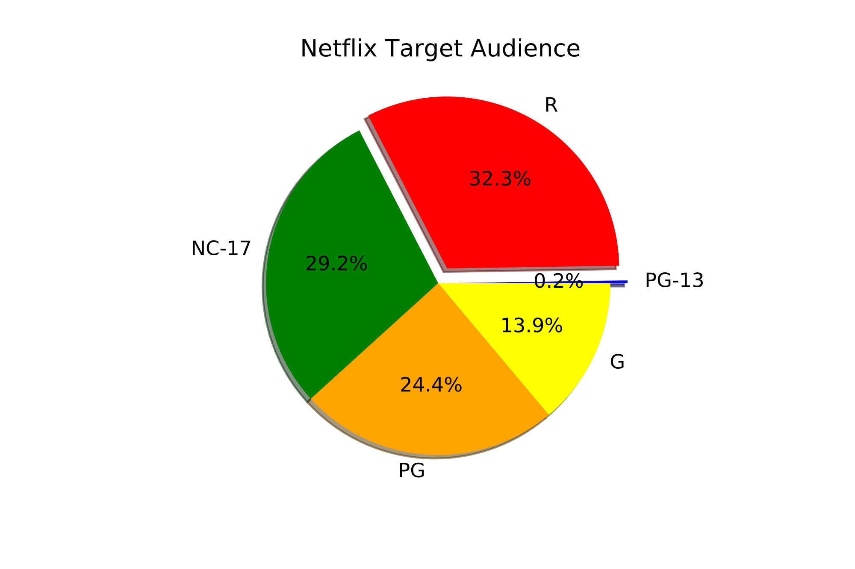
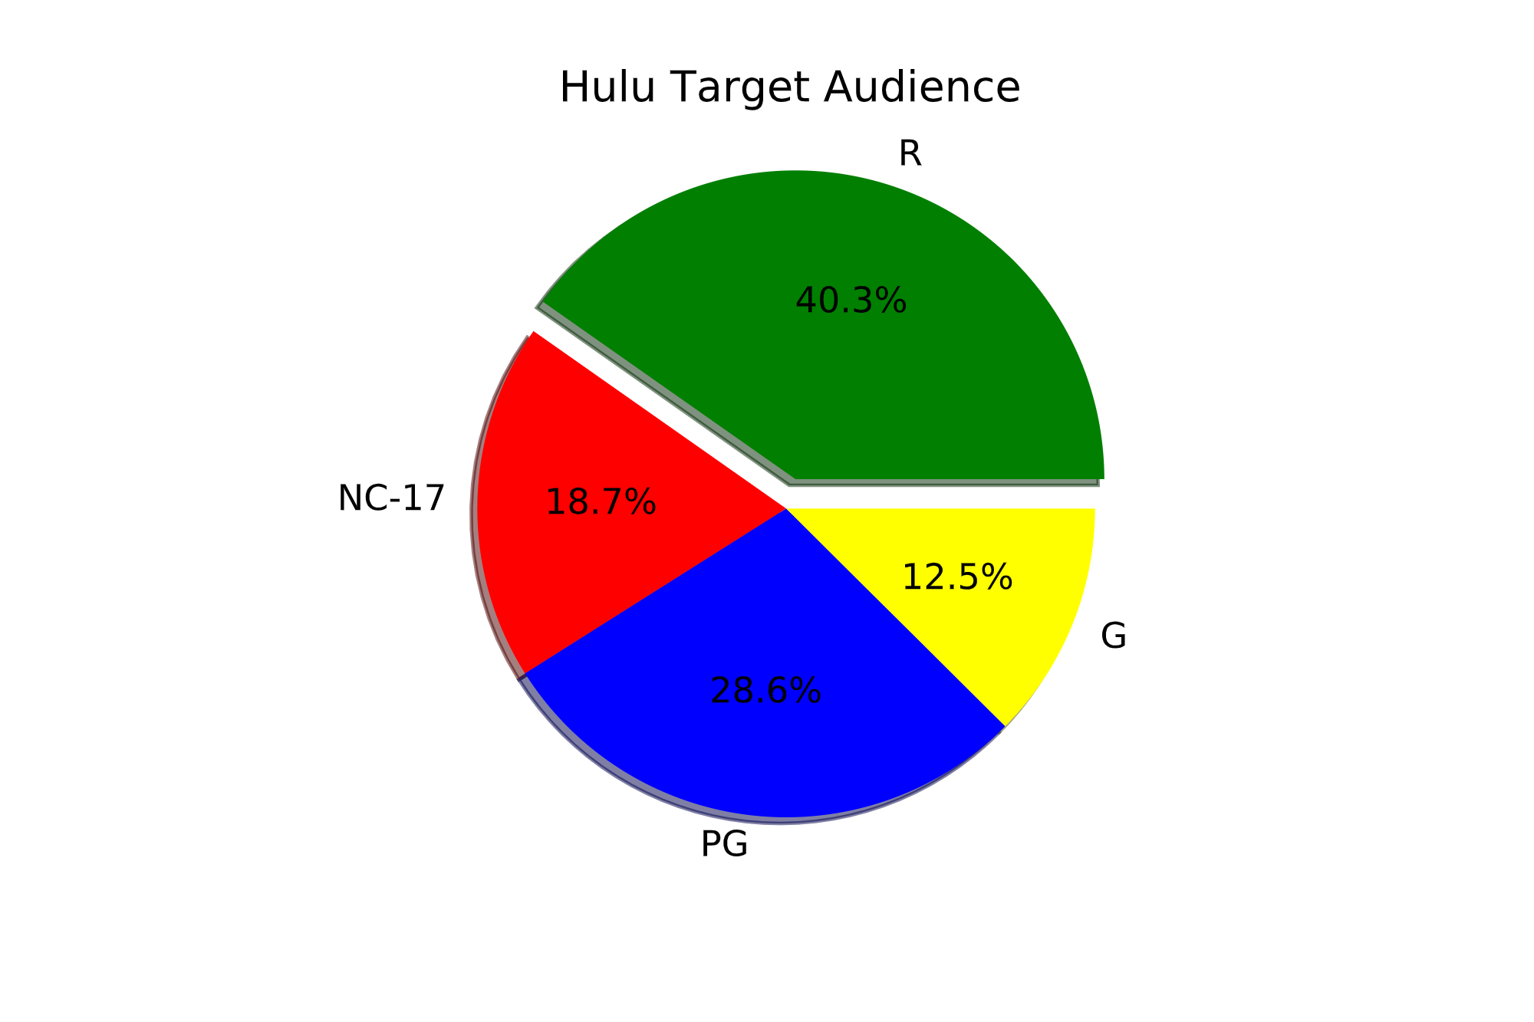
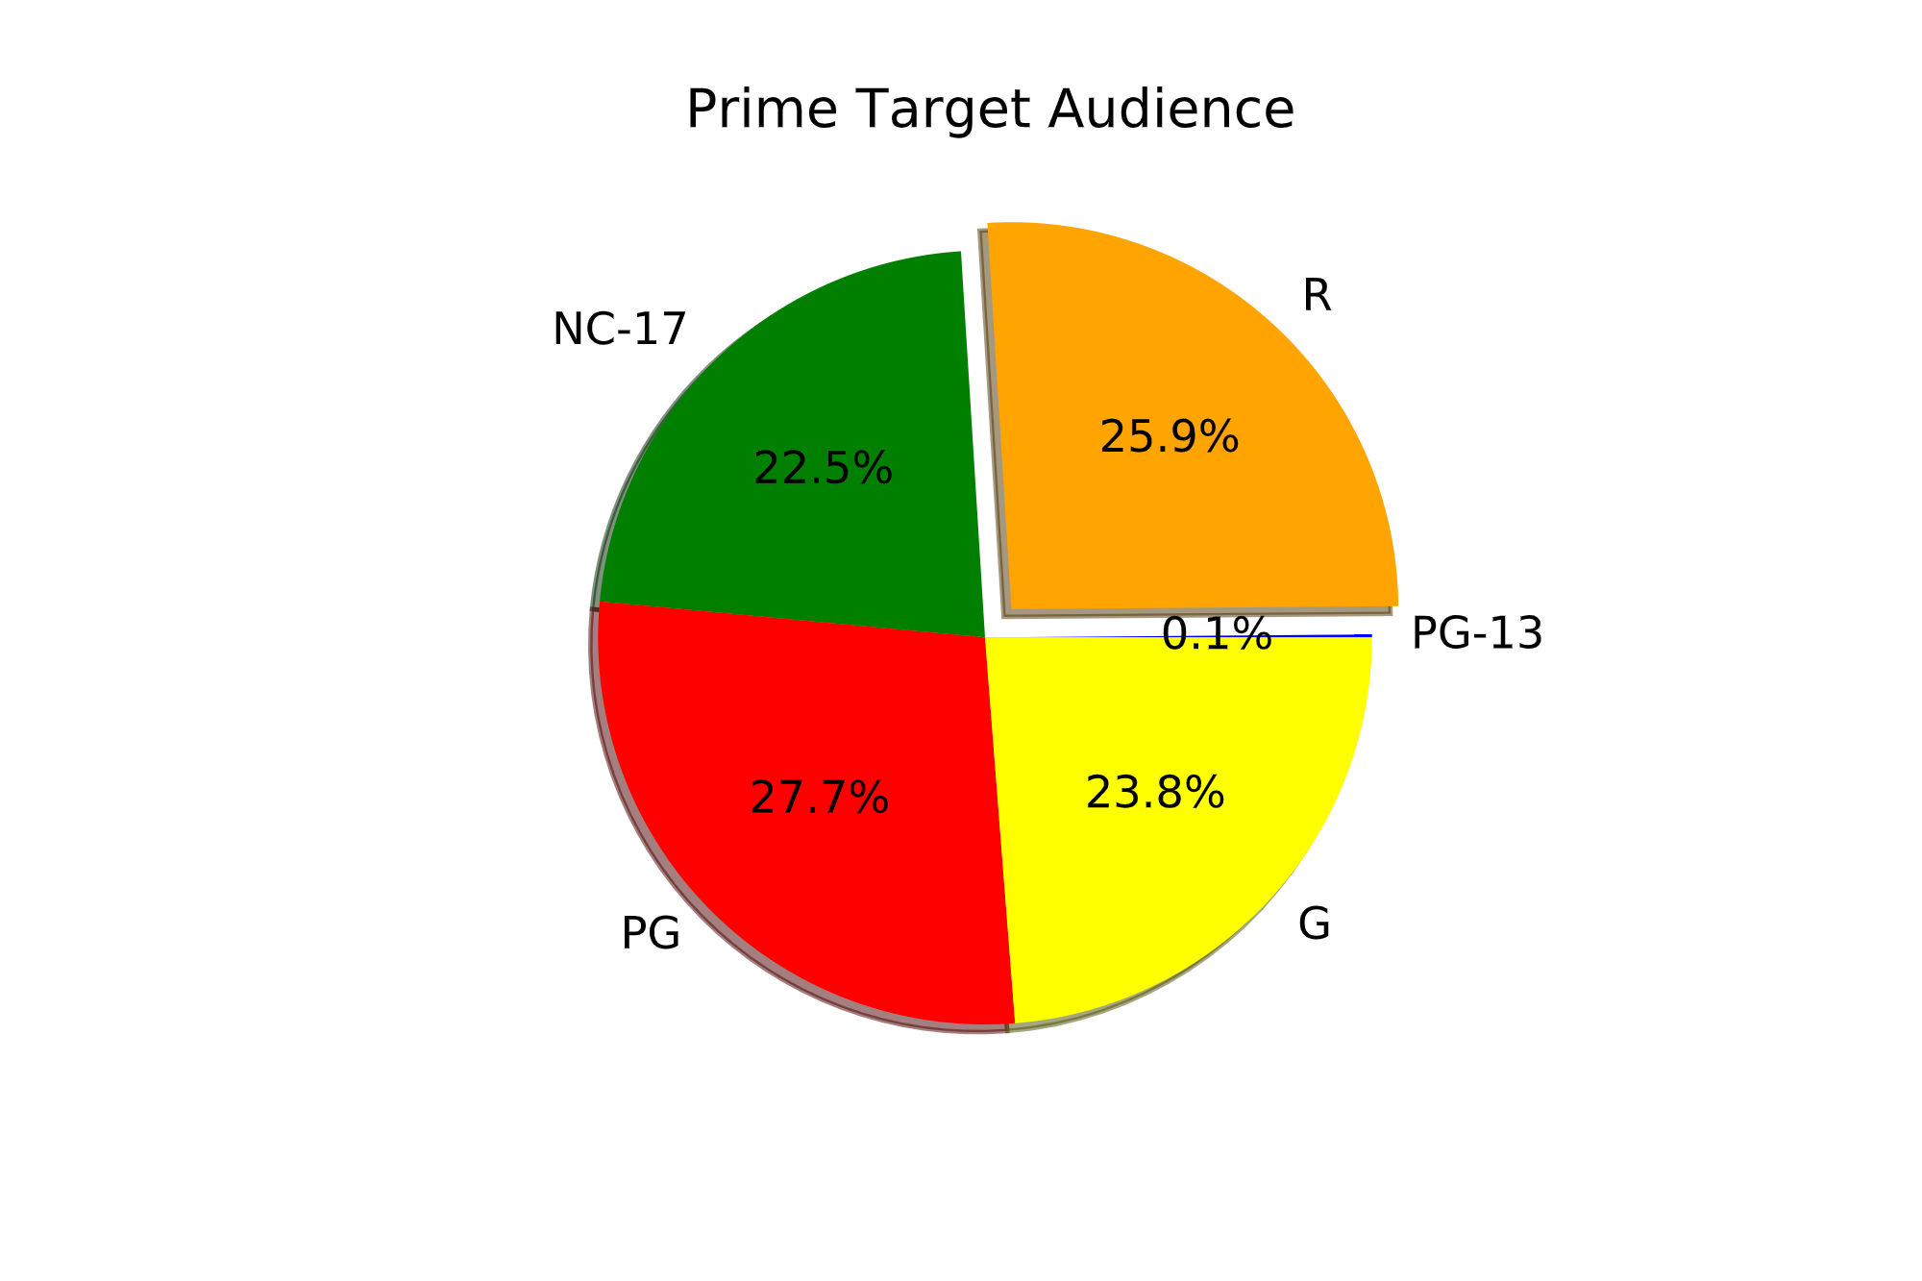
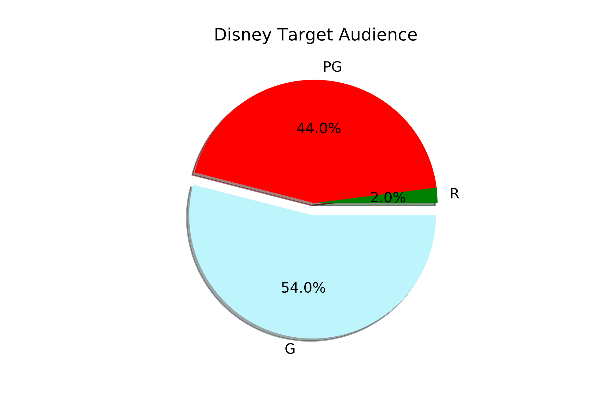

Slide 5
When Are Most Shows Produced?

Slide 6
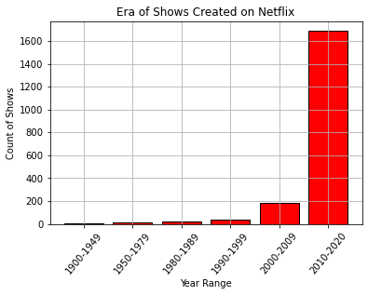
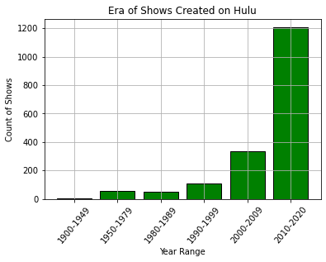
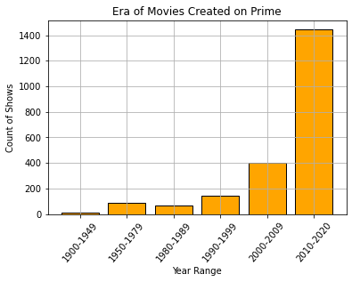
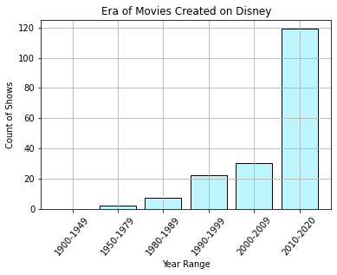

Slide 7
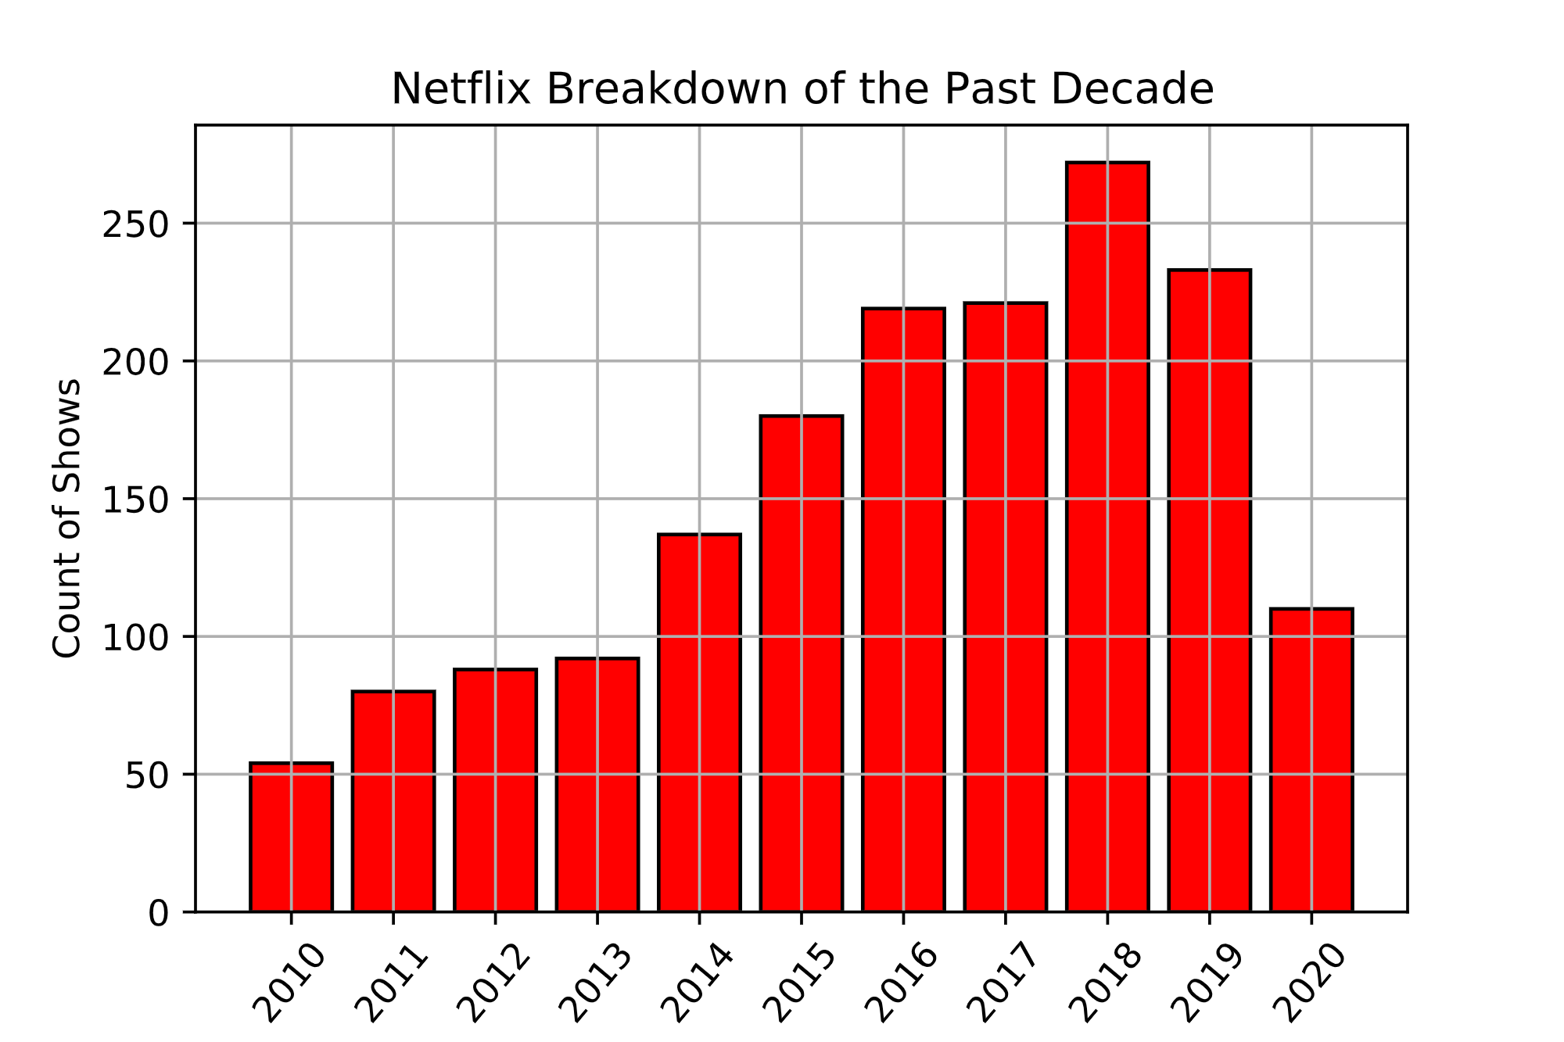
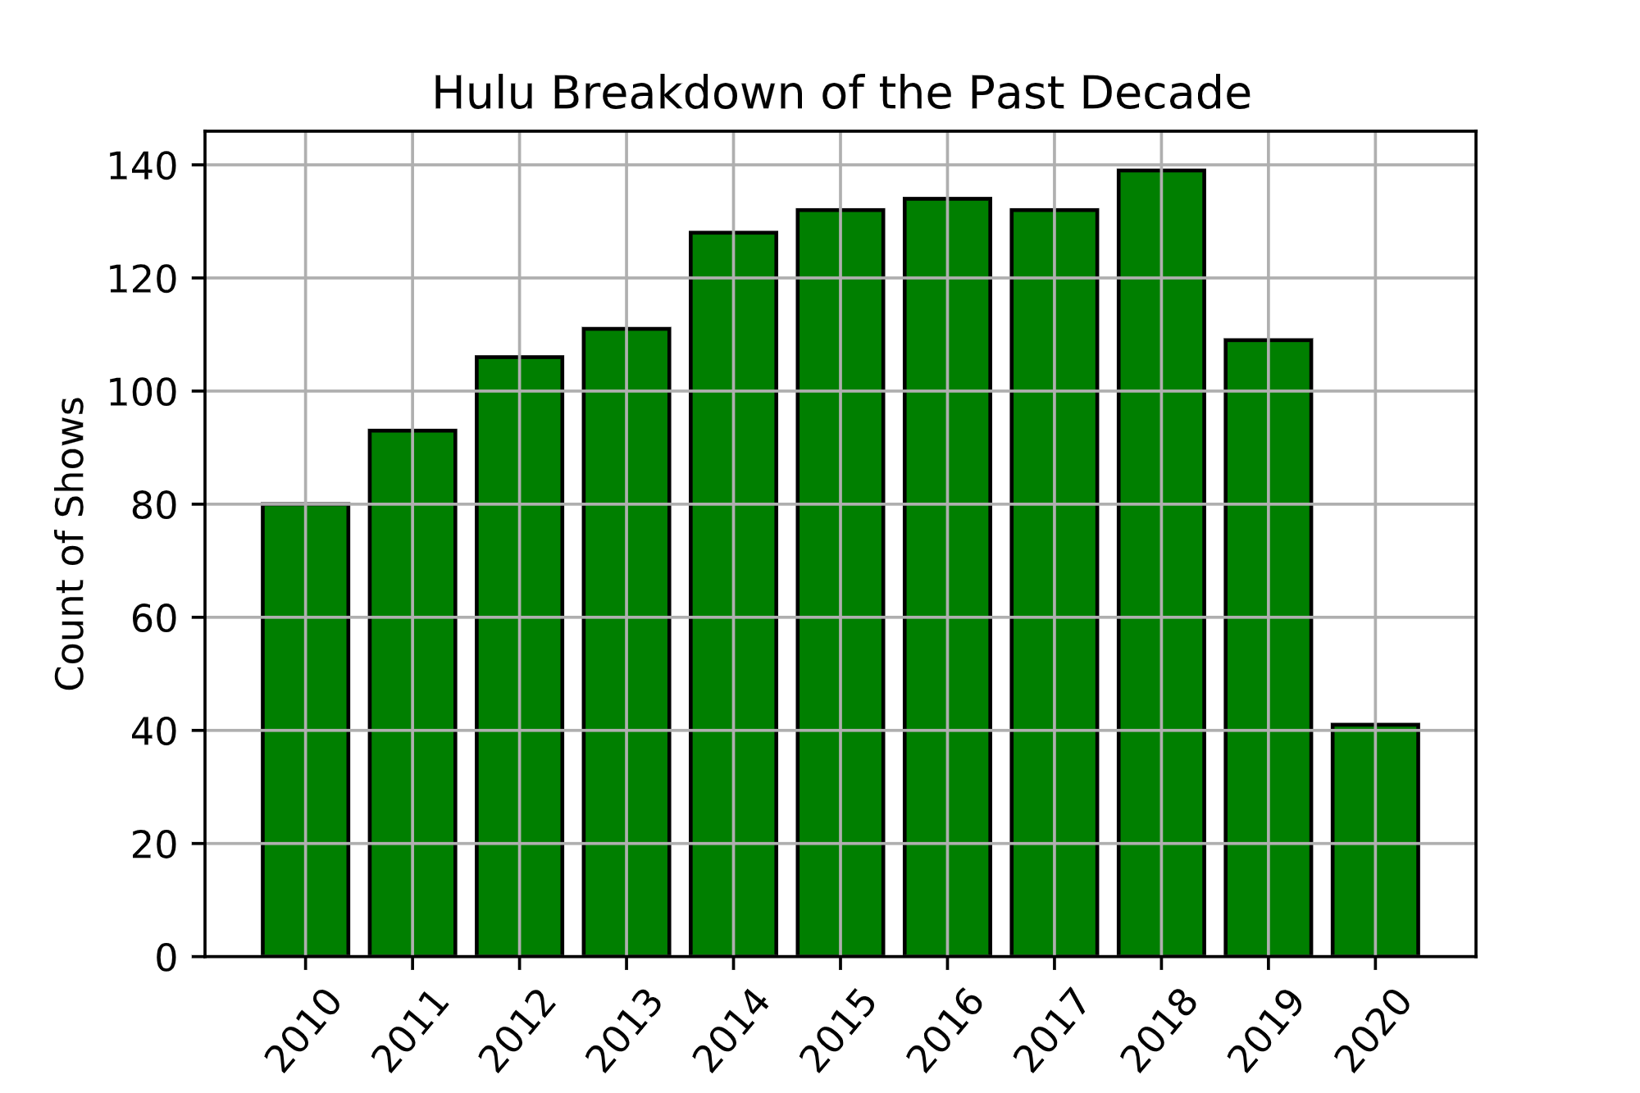
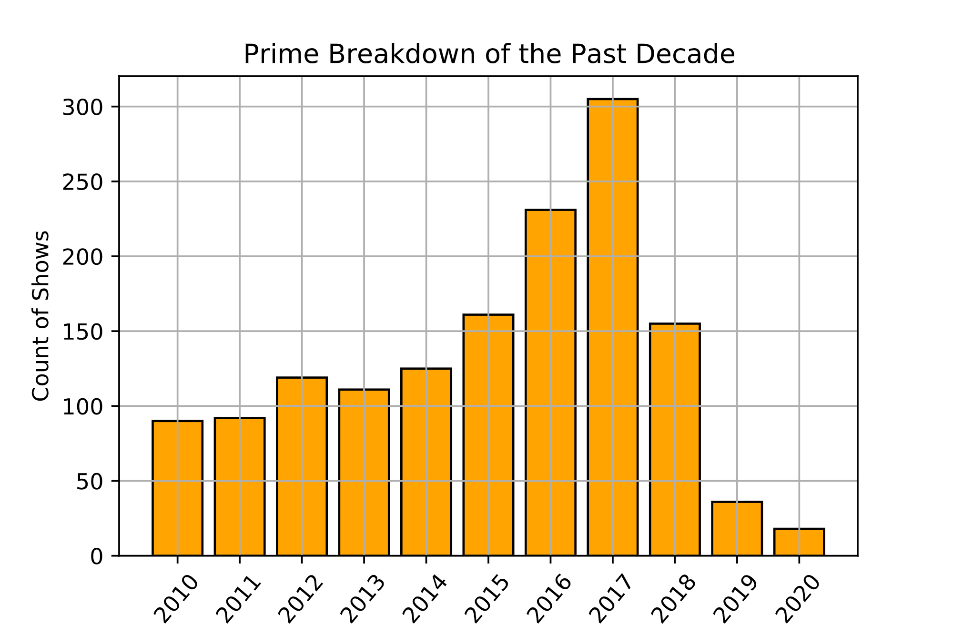
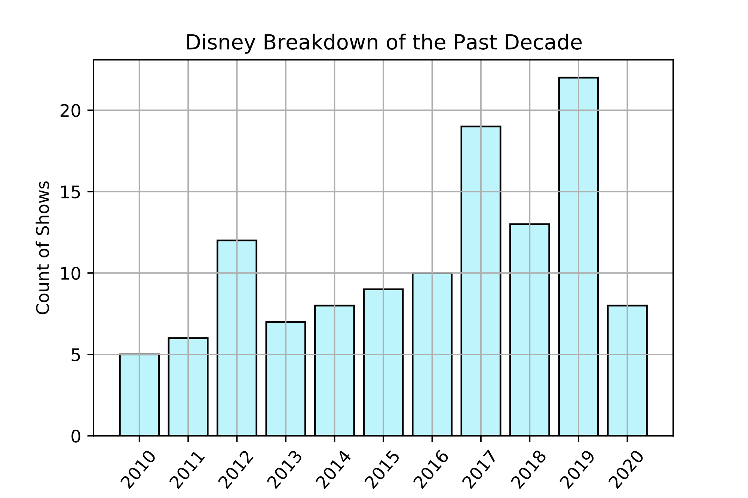

Slide 8


Difference Between IMDB & Rotten Tomatoes

Slide 9
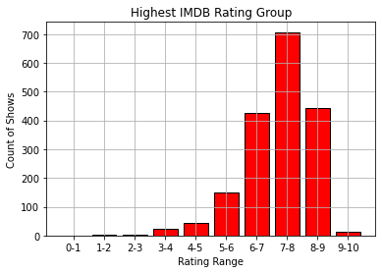
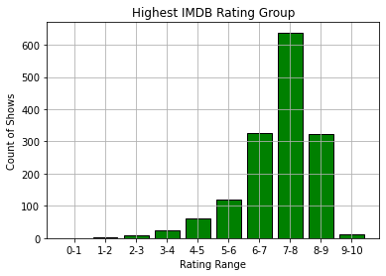
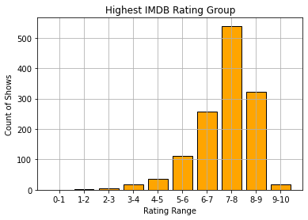
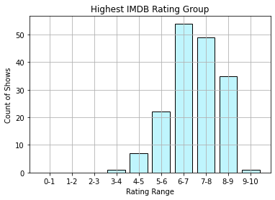

Slide 10
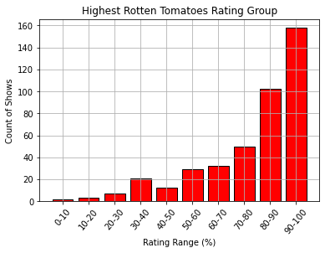
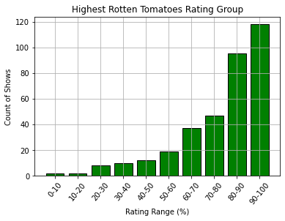
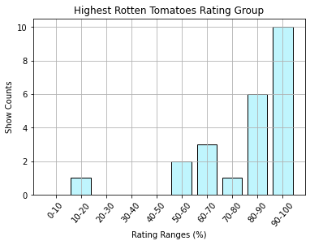
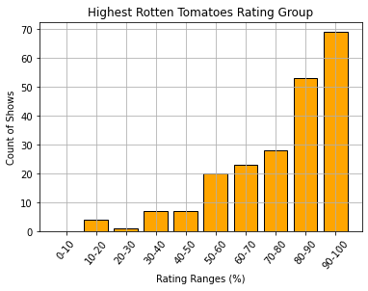

Slide 11
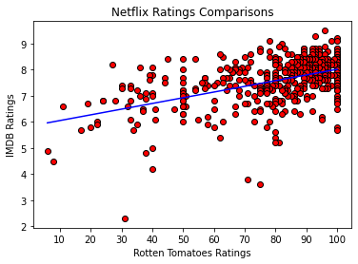
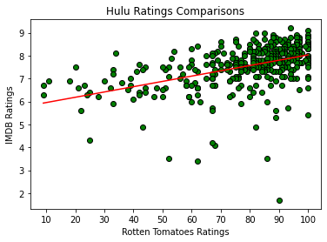
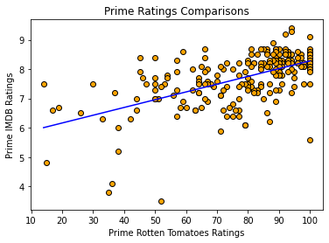
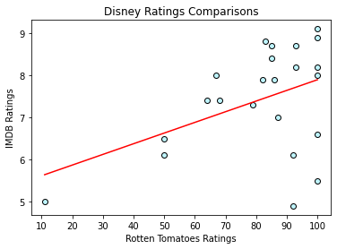

Slide 12
Show Recommendations!

Slide 13
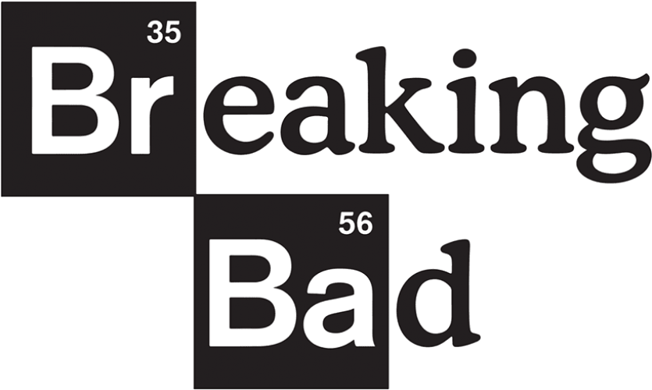


Netflix
Hulu

Slide 14



Prime
Disney

Slide 15
Summary
Platform | Total Shows | Target Age Group | Average IMDB Rating | Highest IMDB Rated Show | Average Rotten Tomatoes Rating (%) | Highest Rotten Tomatoes Rated Show | Correlation IMDB vs Rotten Tomatoes
Netflix | 1931 | 16+ | 7.16 | Breaking Bad (9.5) | 78.32 | The Last Airbender (100%) | 0.49
Hulu | 1754 | 16+ | 7.06 | Destiny (9.6) | 78.20 | Fullmetal Alchemist: Brotherhood (100%) | 0.46
Disney | 180 | All | 6.92 | The Imagineering Story (9.1) | 81.17 | The Imagineering Story (100%) | 0.44
Prime | 2144 | 16+ | 7.18 | Malgudi Days (9.5) | 77.21 | The Planets (100%) | 0.57

